Slide 1
C66x CorePac: Achieving High Performance
Notes:
1
NEW

Slide 2
Agenda
CorePac Architecture
Single Instruction Multiple Data (SIMD)
Memory Access
Pipeline Concept

Slide 3
CorePac Architecture
CorePac Architecture
Single Instruction Multiple Data (SIMD)
Memory Access
Pipeline Concept

Slide 4
C66x CorePac
C66x CorePac
CorePac includes:
DSP Core
Two registers
Four functional units per register side
L1P memory (Cache/RAM)
L1D memory (Cache/RAM)
L2 memory (Cache/RAM)
Level 1 Program
Memory (L1P)
Single-Cycle
Cache / RAM
Level 2
Memory
(L2)
Program / Data
Cache / RAM
256
DSP Core
Instruction Fetch
M
L
M
L
S
D
S
D
Reg A [32]
Reg B [32]
Memory Controller
64-bit
Level 1 Data
Memory (L1D)
Single-Cycle
Cache / RAM

Slide 5
C66x DSP Core
Memory
A0
.D1
.D2
B0
Four functional units per side:
Multiplier (.M)
ALU (.L)
Data (.D)
Control (.S)
These independent functional units enable efficient execution of parallel specialized instructions:
Multiplier (.M1and.M2) and ALU (.L1 and .L2) provide MAC (multiple accumulation) operations.
Data (.D) provides data input/output.
Control (.S) provides control functions (loop, branch, call).
Each DSP core dispatches up to eight parallel instructions each cycle.
All instructions are conditional, which enables efficient pipelining.
The optimized C compiler generates efficient target code.
.S1
.S2
MACs
.M1
.M2
. .
.L1
.L2
. .
A31
B31
Controller/Decoder

Slide 6
C66x DSP Core Cross-Path
Register File A
Register File B
Any 64-bit pair of registers from A can be one of the inputs to a B functional unit, and vice versa.
A0
B0
A1
B1
A2
B2
A3
B3
A4
B4
. . .
. . .
A
B
.D1
.D1
A31
.S1
.S1
B31
.M1
.M1
.L1
.L1

Slide 7
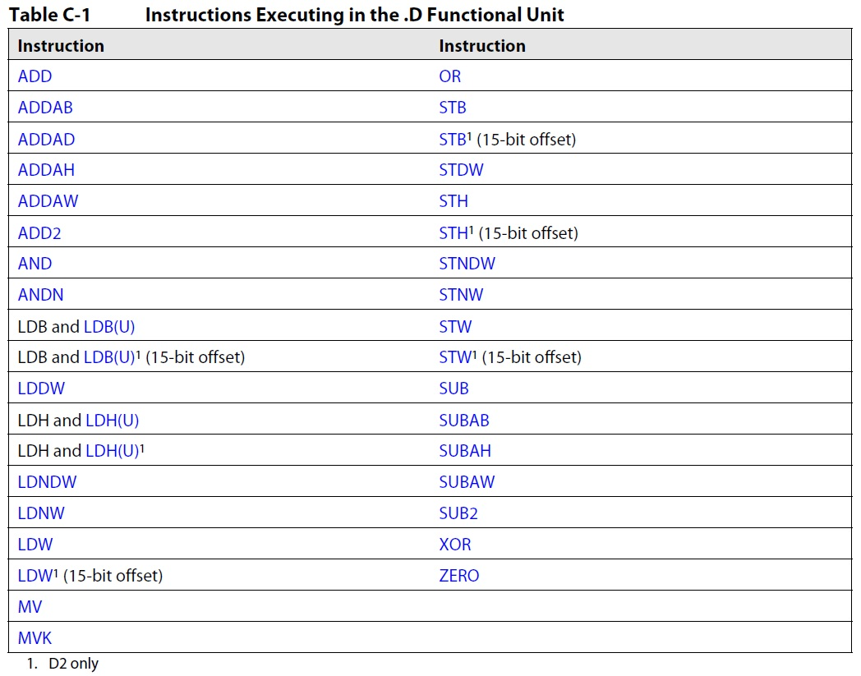
Partial List of .D Instructions

Slide 8
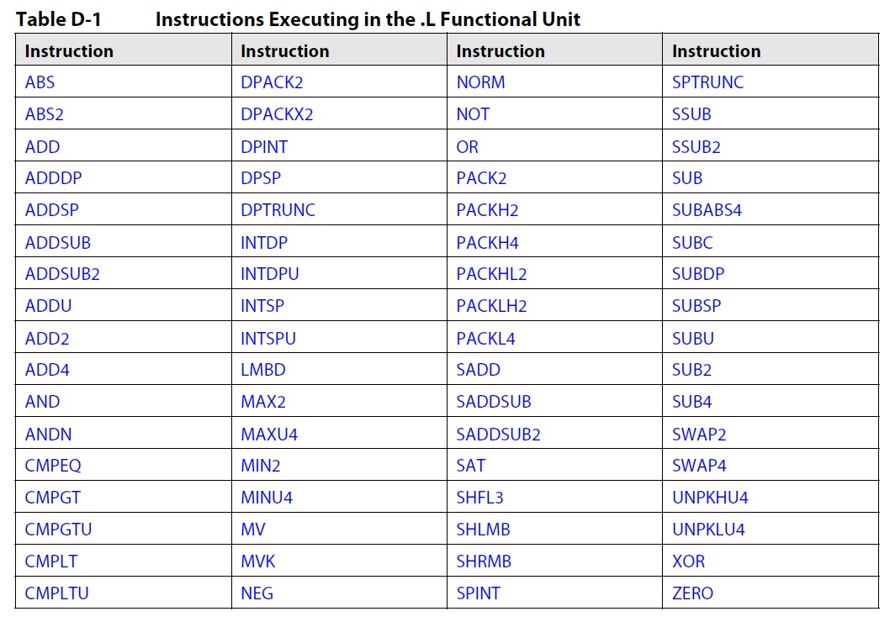
Partial List of .L Instructions

Slide 9
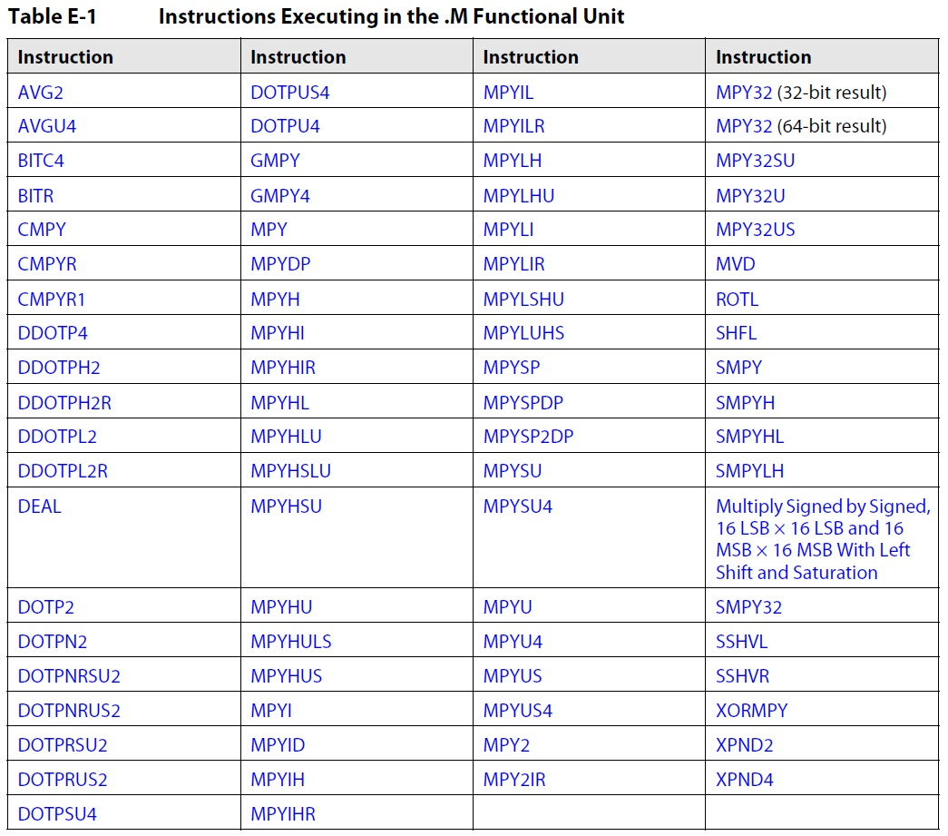
Partial List of .M Instructions

Slide 10
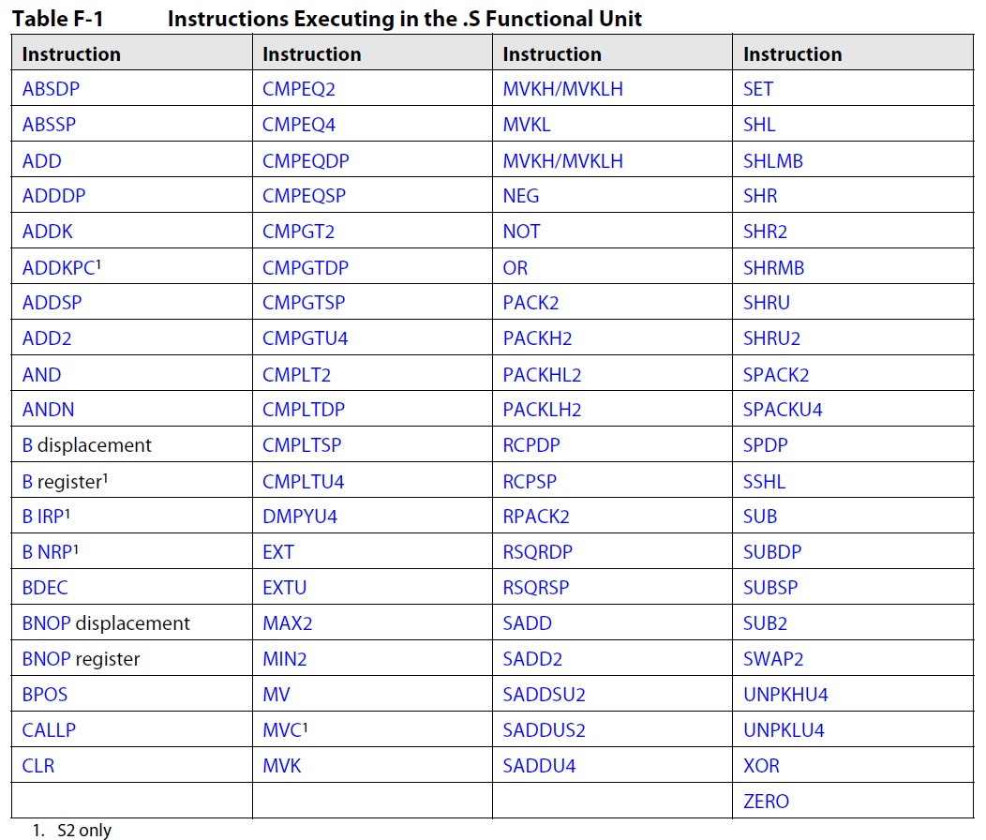
Partial List of .S Instructions

Slide 11
C66x CorePac Improvements Over C64x+
Wider internal bus
64 bit for the .L and .S functional units
128 bit for the .M functional unit
Wider cross path
64 bit for each direction
4x number of multipliers
More SIMD instructions
Enhanced instruction set
More than 100 new instructions added (compared to c64+)

Slide 12
Enhanced C66x Instruction Set
New SIMD instructions:
QMPY32 – 4-way SIMD of MYP32
DDOTP4H – 2-way SIMD of DOTP4H
DPACKL2 – SIMD version of PACKL2
DAVGU4 – Average of 8 packed unsigned bytes
New floating-point instructions:
MPYDP – Double Precision Multiplication
FMPYDP – Fast Double Precision multiplication
DINTSP – 2-Way SIMD Convert 32-bits Unsigned Integer to Single Precision Floating Point

Slide 13
Interesting New C66x Instructions
MFENCE (Memory Fence) Stall instruction pipeline until memory system is done.
RCPSP (Single-Precision Floating-Point Reciprocal Approximation)
RSQRSP (Single-Precision Floating-Point Square-Root Reciprocal Approximation)

Slide 14
Single Instruction Multiple Data (SIMD)
CorePac Architecture
Single Instruction Multiple Data (SIMD)
Memory Access
Pipeline Concept

Slide 15
C66x SIMD Instructions: Examples
ADDDP – Add Two Double-Precision Floating-Point Values
DADD2 – 4-Way SIMD Addition, Packed Signed 16-bit
Performs 4 additions of two sets of 4 16-bit numbers packed into 64-bit registers.
The 4 results are rounded to 4 packed 16-bit values
unit = .L1, .L2, .S1, .S2
FMPYDP - Fast Double-Precision Floating Point Multiply
QMPY32 - 4-Way SIMD Multiply, Packed Signed 32-bit.
Performs 4 multiplications of two sets of 4 32-bit numbers packed into 128-bit registers.
The 4 results are packed 32-bit values.
unit = .M1 or .M2

Slide 16
C66x SIMD Instruction: CMATMPY
Many applications use complex matrix arithmetic.
CMATMPY – 2x1 Complex Vector Multiply 2x2 Complex Matrix
Results in 1x2 signed complex vector.
All values are 16-bit (16-bit real/16-bit Imaginary)
unit = .M1 or .M2
How many multiplications are complex multiplication, where each complex multiplication has the following?
4 complex multiplications (4 real multiplications each)
Two M units (16 multiplications each) = 32 multiplications
Core cycles per second (1.25 G)
Total multiplications per second = 40 G multiplications
8 cores = 320 G multiplications
The issue here is, can we feed the functional units data fast enough?

Slide 17
Feeding the Functional Units
There are two challenges:
How to provide enough data from memory to the core
Access to L1 memory is wide (2 x 64 bit) and fast (0 wait state)
Multiple mechanisms are used to efficiently transfer new data to L1 from L2 and external memory.
How to get values in and out of the functional units
Hardware pipeline enables execution of instructions every cycle.
Software pipeline enables efficient instruction scheduling to maximize functional unit throughput.

Slide 18
Memory Access
CorePac Architecture
Single Instruction Multiple Data (SIMD)
Memory Access
Pipeline Concept

Slide 19
Internal Buses
Program Address x32
PC
L1
Memories
Program Data x256
Fetch
Data Address - T1 x32
A
Regs
Data Data - T1 x32/64
L2 and
External
Memory
Data Address - T2 x32
B
Regs
Data Data - T2 x32/64
Peripherals
C62x: Dual 32-Bit Load/Store
C67x: Dual 64-Bit Load / 32-Bit Store
C64x, C674x, C66x: Dual 64-Bit Load/Store

Slide 20
Pipeline Concept
CorePac Architecture
Single Instruction Multiple Data (SIMD)
Memory Access
Pipeline Concept

Slide 21
Non-Pipelined vs. Pipelined CPU
Clock Cycles
CPU Type
1 2 3 4 5 6 7 8 9
Non-Pipelined
F₁ D₁ E₁
F₂ D₂ E₂
F₃ D₃ E₃
Pipelined
F₁ D₁ E₁
F₂ D₂ E₂
F₃ D₃ E₃
Stage | Pipeline Function
F Fetch | Generate program fetch address Read opcode
D Decode | Route opcode to functional units Decode instructions
E Execute | Execute instructions
Pipeline full
Now look at the C66x pipeline.

Slide 22
Program Fetch Phases
Phase | Description
PG | Generate fetch address
PS | Send address to memory
PW | Wait for data ready
PR | Read opcode
C66x Core
Functional
Units
PR
Memory
PG
PS
PW

Slide 23
Pipeline Phases - Review
Program Fetch
Decode
Execute
PG PS PW PR D E
PG PS PW PR D E
PG PS PW PR D E
PG PS PW PR D E
PG PS PW PR D E
PG PS PW PR D E
Single-cycle performance is not affected by adding three program fetch phases.
That is, there is still an execute every cycle.
How about decode? Is it only one cycle?

Slide 24
Decode Phases
Decode Phase | Description
DP | Intelligently routes instruction to functional unit (dispatch)
DC | Instruction decoded at functional unit (decode)
C66x Core
Functional
Units
PR
DP
DC
Memory
PG
PS
PW

Slide 25
Pipeline Phases
Program Fetch
Decode
Execute
PG PS PW PR DP DC E1
PG PS PW PR DP DC E1
PG PS PW PR DP DC E1
PG PS PW PR DP DC E1
PG PS PW PR DP DC E1
PG PS PW PR DP DC E1
PG PS PW PR DP DC E1
Pipeline Full
How many cycles does it take to execute an instruction?
Notes:
Should the EXECUTEs be sequential here? E1, E2. E3, etc.

Slide 26
Instruction Delays
All C66x instructions require only one cycle to execute, but some results are delayed.
Description | Instruction Example | Delay
Single Cycle | All instructions except | 0
Integer multiplication and new floating point | MPY, FMPYSP | 1
Legacy floating point multiplication | MPYSP | 2
Load | LDW | 4
Branch | B | 5

Slide 27
Software Pipeline Example
Dot product; A typical DSP MAC operation.
LDH
|| LDH
MPY
ADD
How many cycles would it take to perform this loop five times?
(Disregard delay slots).
______________ cycles

Slide 28
Software Pipeline Example
Dot product; A typical DSP MAC operation.
LDH
|| LDH
MPY
ADD
How many cycles would it take to perform this loop five times?
(Disregard delay slots).
5 x 3 = 15 cycles

Slide 29
Non-Pipelined Code
Cycle
1
.D1
ldh
.D2
ldh
.M1
.M2
.L1
.L2
.S1
.S2
2
mpy
3
add
4
ldh
ldh
5
mpy
6
add
7
ldh
ldh
8
mpy
9
add
Notes:
Indicate here how many cycles this code processing will require (15 cycles)

Slide 30
Pipelining Code
Cycle
1
.D1
ldh
.D2
ldh
.M1
.M2
.L1
.L2
.S1
.S2
2
ldh
ldh
mpy
3
ldh
ldh
mpy
add
4
ldh
ldh
mpy
add
5
ldh
ldh
mpy
add
6
No LDHs?
mpy
add
7
add
Pipelining these instructions took 1/2 the cycles!

Slide 31
Software Pipeline Support
The compiler is smart enough to schedule instructions efficiently.
DSP algorithms are typically loop intensive.
Generally speaking, servicing of interrupts is not allowed in the middle of the loop because fixed timing is essential.
The C66x hardware SPLOOP enables servicing of interrupts in the middle of loops.
NOTE: For more information on SPLOOP, refer to Chapter 8 of the C66x CPU and Instruction Set Reference Guide.

Slide 32
For More Information
For more information, refer to the C66x CPU and Instruction Set Reference Guide.
For questions regarding topics covered in this training, visit the support forums at the TI E2E Community website.

